Slide 1
Markless
Furniture
Marker-less AR furniture Interactive Designing

Slide 2
Markless Furniture
Sri Lanka Institute of Information Technology
Supervisor
Mr: Udara Samarathunga
Group Members
N.J.De Silva
D.G.T.K.Jayathilaka
R.K.A.D.C.Ranaweera
A.K.S.Y.Alawatta
Markless
01
Furniture

Slide 3
Agenda
INTRODUCTION
RESEARCH PROBLEM
EXISTING SYSTEMS AND PROPOSED PRODUCT
MAIN FEATURES

Slide 4
TOOLS AND TECHNOLOGIES
SYSTEM DIAGRAM
DEMONSTRATION & USER BENEFITS OF THE SYSTEM
POTENTIAL USERS

Slide 5
MARKETING STRATEGY
REFERENCES
FINISH

Slide 6
INTRODUCTION

Slide 7
Welcome to Markless Furniture
Marker-Less AR furniture interactive Layouting
Augmented Reality is a technique which uses a mobile device’s camera to superimpose a computer-generated image or 3D model on to a user’s view of the real world
Markless
01
Furniture

Slide 8



Research Problem
Markless
Furniture
02

Slide 9









Comparison of Existing Products
Features
Augment
VIUTEKuDecore
Sayduck
Augmented Furniture
Our Solution
Medium
Marker-less AR
Support multiple objects
Support customization Suggestion feature
Voice recognition
Augmented object details
Support Android devices
Marker-less AR
Support multiple objects
Support customization In app user feedback
Augmented object details
Support android
Scale detection
Markless
03
Furniture

Slide 10




Main Features
Features provided by system
AR furniture placement
3D models of furniture which can be placed in their home to identify where it suit them before purchasing actual product.
Customize furniture
Customize furniture as customer requires.
Voice recognize
Allow customer the ease of customizing.
Furniture Suggestions
Allow customer the ease of customizing.
Markless
04
Furniture

Slide 11








Technology
Technologies used for development
Kudan AR
Unity 3D
Android device
Azure cloud service
Android SDK
Open CV
Microsoft SQL server
Microsoft Visual Studio 2015
Amazon Web Services S3
Markless
05
Furniture

Slide 12









System Diagram
Scale Identification
Augmented placement
Suggestions
Voice Recognition
Markless
06
Furniture

Slide 13

Scale identification of Real-world objects
Mapping and 3D object placement component Flow
Camera feed
Process Frames
Adjust tracking strength
Set approximate distance to detected object
Display relevant furniture details
Calculate Other Dimensions
Calculate Height of the object
Markless
07
Furniture

Slide 14
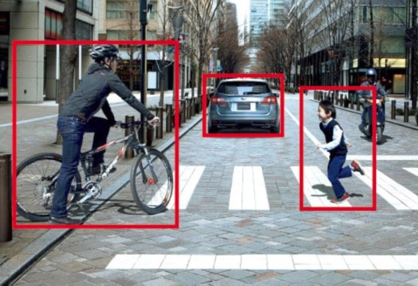
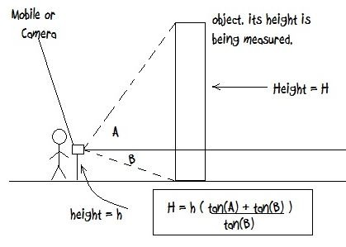
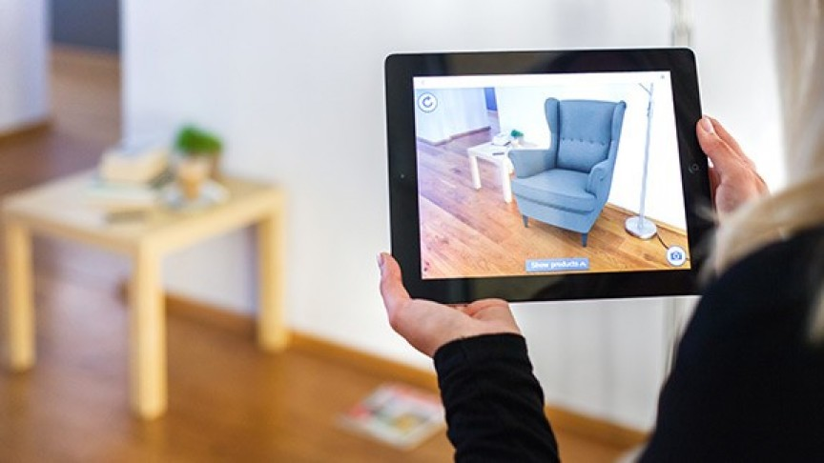
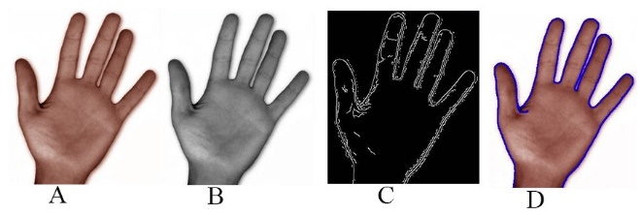
Scale Identification
Detect Objects using Contours
Calculate Dimensions respect to assumed distance.
Give inputs to scale the 3D object to be more realistic.
Markless
08
Furniture

Slide 15

Markless
09
Furniture

Slide 16


AR Furniture Placement
Marker-less Furniture placement component Flow
Extract furniture models
Instantaneous Augmentation
Select 3D object
Scale identification component
Identify direction when
Tracking lost
Markless
11
Furniture

Slide 17


Real-time suggestions
Suggestions component Flow
Acquire Image
Upload to cloud server
Preprocess image
and
generate suggestions
Display relevant furniture details
Send output to mobile application
Markless
13
Furniture

Slide 18
Process flow inside API
Original input Image
Fix contrast issues (Histogram Processing)
Scale down image
Check for contrast issues
Match furniture (Euclidean distance)
Select prominent colors
Extract color information
Cluster similar colors (K-means algorithm)
Return matching furniture
Markless
14
Furniture

Slide 19


Voice Recognition
Voice Recognition and customizing flow
Voice recognition algorithm
Acquire Image
And
Voice
Convert voice to Text
Extract furniture
detail
Apply Voice commands
Display updated furniture
Send output to mobile application
Text to voice convert algorithm
Voice description
Convert Text to Voice
Markless
Furniture
16

Slide 20






Achievable User Benefits of the System
Increase of Profitability
Retain Customers and Improve customer service
Increase of customer satisfaction
Markless
Less burden on furniture transporter
Furniture
Motivation and improve of customer feedbacks
Improvement to quality of products
Markless
18
Furniture

Slide 21

Potential Users
Benefited from the system
Furniture buying customers.
Sales representatives of Furniture manufacturers.
Markless
19
Furniture

Slide 22
Business Model
Markless
20
Furniture

Slide 23
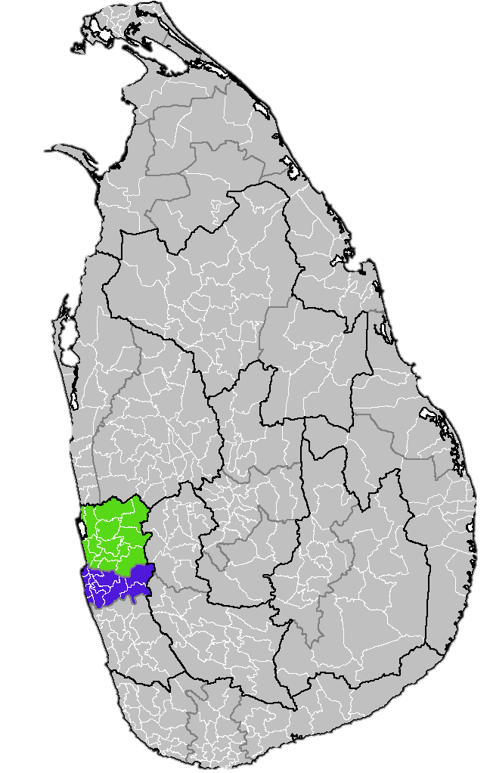
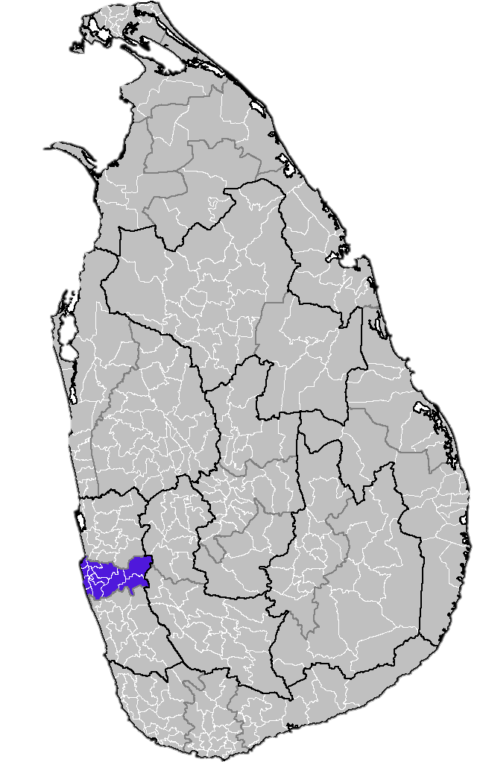
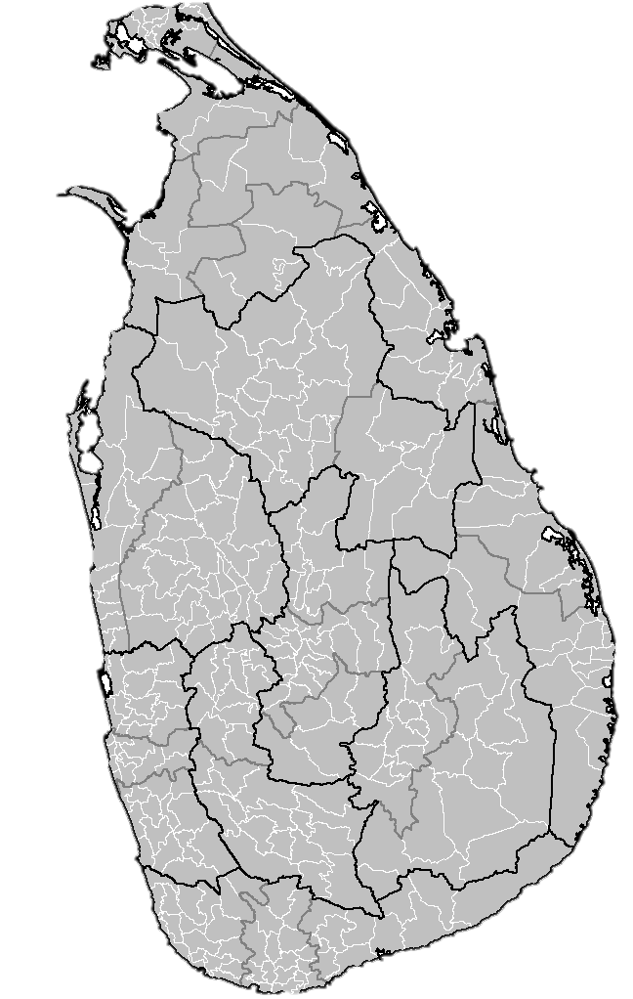
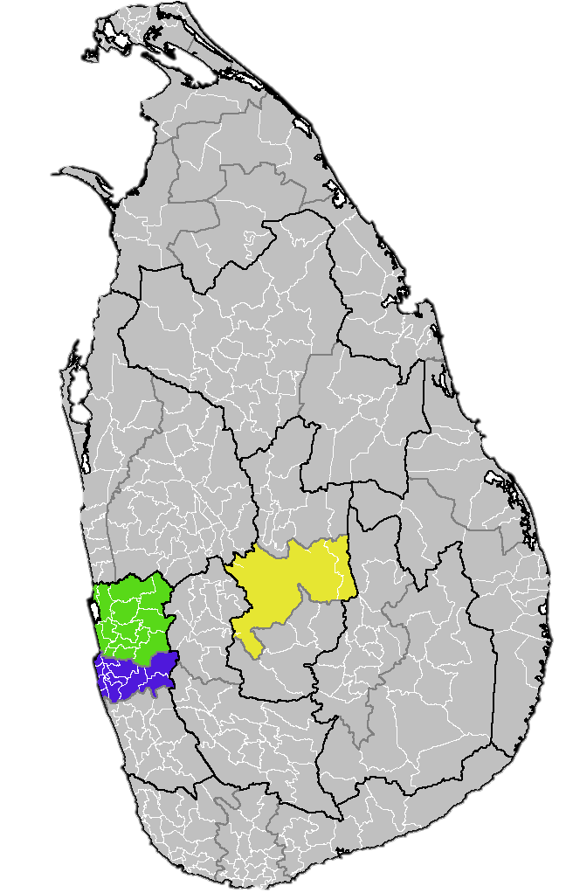
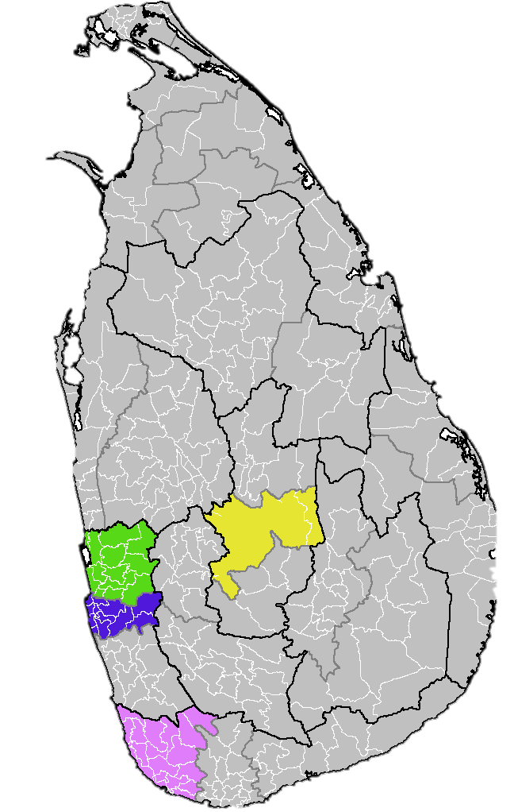
Local Market
Sri Lankan e-commerce Application
Usage
Cost for Monthly subscribers per
Quarter
2,600,000
1-10 uploads : 50 $
10-50 uploads : 75 $
50+ uploads : 150 $
Target for 1st Quarter of 2017
40%
Colombo
Gampaha
Kandy
Galle
Total revenue for 1st Quarter (2017)
Targeted Local Furniture Market
(by Local Distributors )
Rs.100,000.00
35%
Markless
21
Furniture
Notes:
http://www.kaymu.lk/research/
http://www.damro.lk/

Slide 24
Global Market
e-commerce Application
Usage in Asia
559,003,000
Target for 1st year
25%
Cost for international Subscribers
20%
1-20 uploads : 120 $
20-55 uploads : 200 $
55+ uploads : 350 $
Targeted Asia Furniture Market
(by Distributors )
Markless
22
Furniture
Notes:
References:
http://www.internetworldstats.com/stats3.htm
http://www.damro.lk/about_us.html

Slide 25
References
[1] [Online]. Available: http://www.augment.com/
[2] [Online]. Available: http://www.viutek.com/udecore.html/
[3] [Online]. Available: http://sayduck.com/
[4] [Online]. Available: http://www.augmentedfurniture.com/
Markless
23
Furniture

Slide 26
Thanks for watching
Q&A

Slide 27
Q & A

Slide 28
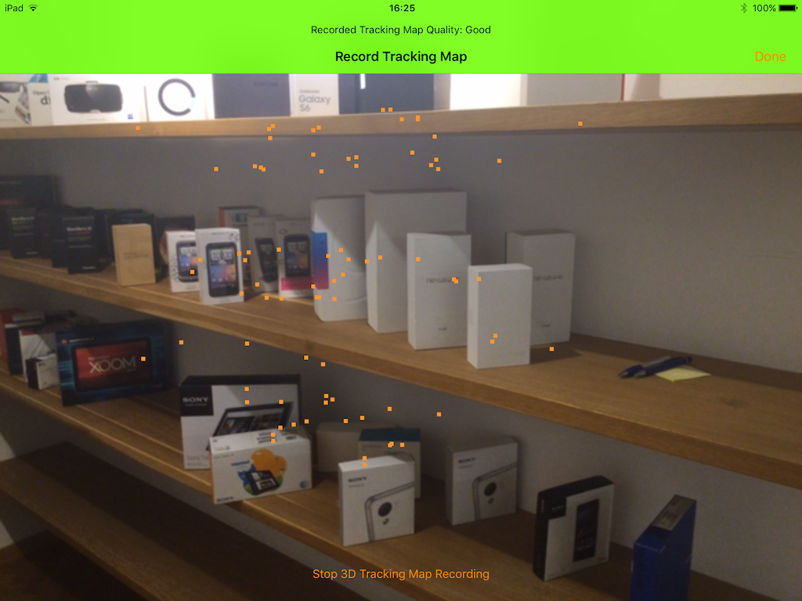

Slide 29
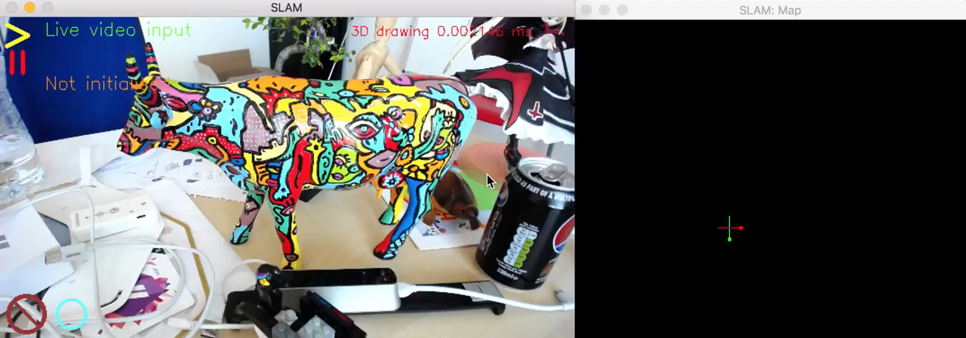

Slide 30
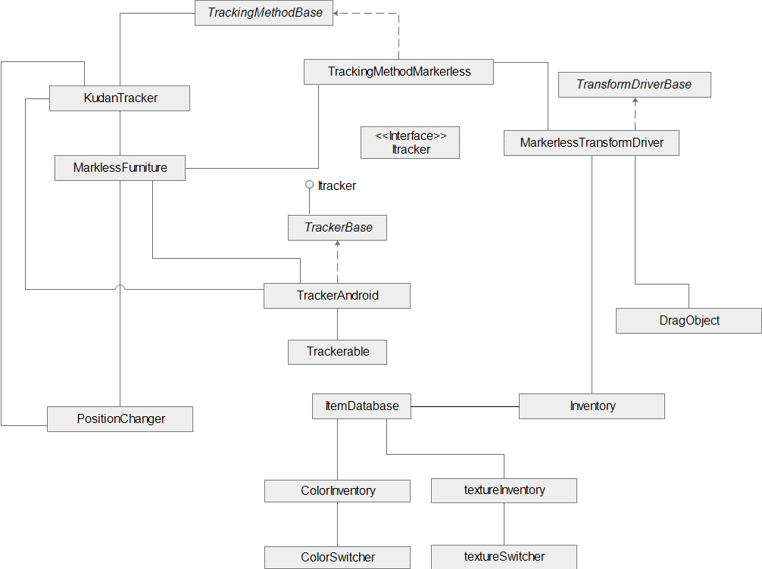

Slide 31
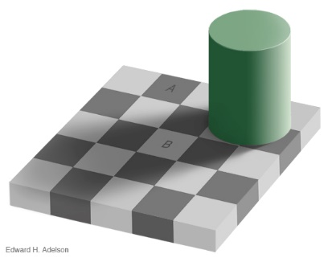
Adelson's checker shadow

Slide 32
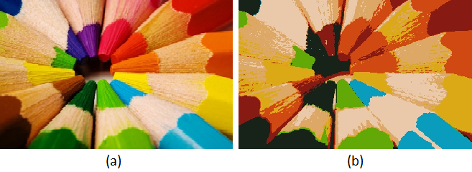
K-means algorithm

Slide 33


Histogram Equalization

