Slide 1
Markless
Furniture
Marker-less AR furniture Interactive Layouting

Slide 2



Research Problem
Markless
Furniture
02

Slide 3
Welcome to Markless Furniture
Marker-Less AR furniture interactive Layouting
Augmented Reality is an image processing technique which uses a mobile device’s camera to superimpose a computer-generated image or 3D model on to a user’s view of the real world
Markless
Furniture

Slide 4
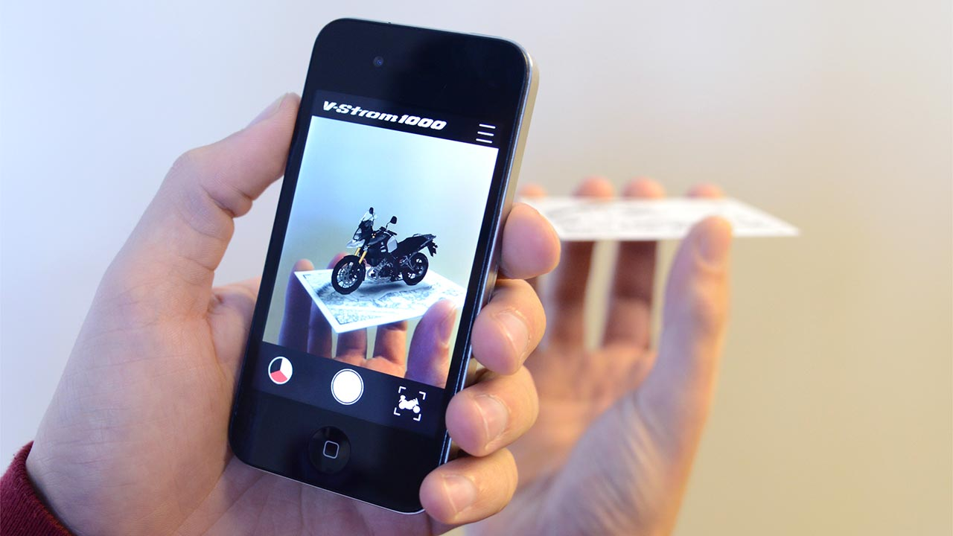
Marker-based AR
Image are provided beforehand.
Exactly what the application should recognize while acquiring camera data.
Markless
Furniture

Slide 5
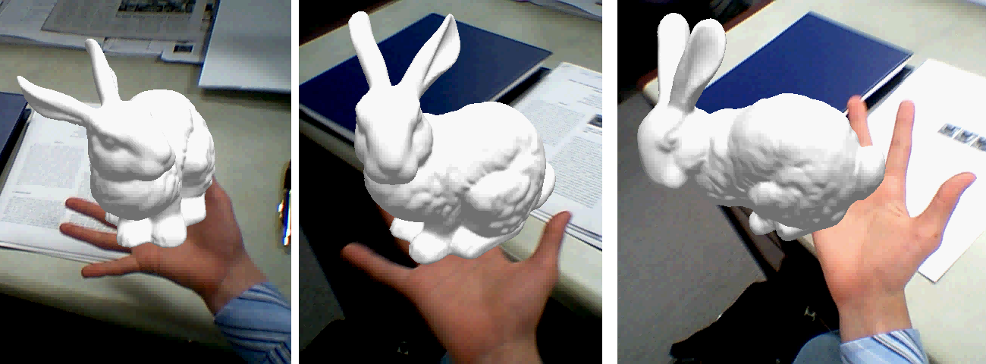
Marker-less AR
Image are not provided beforehand.
Recognition algorithm running in your AR application should identify patterns, colors.
Markless
Furniture

Slide 6
Existing Products
Similar products currently exist in the market
Augment
VIUTEK-uDecore
Sayduck
Augmented furniture
Markless
Furniture

Slide 7

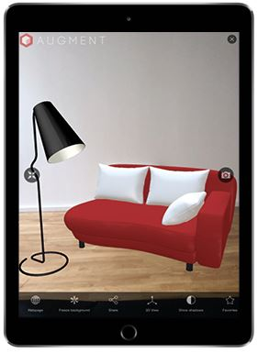
Existing Products
Augment
This is an application for sellers to showcase their product catalog in augmented format to customers.
Customers can scan a specific brochure (Marker) to try out all the products offered by the seller in scale in augmented reality before buying.
Markless
Furniture

Slide 8
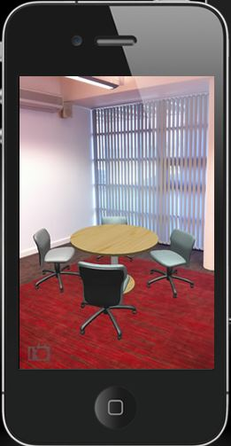
Existing Products
VIUTEK-uDecore
uDecore is our customizable 3D Room Planner.
Can visualize multiple 3D items.
Support hundreds of furniture models that can be customised and placed in a virtual 3D room planner.
Markless
Furniture

Slide 9
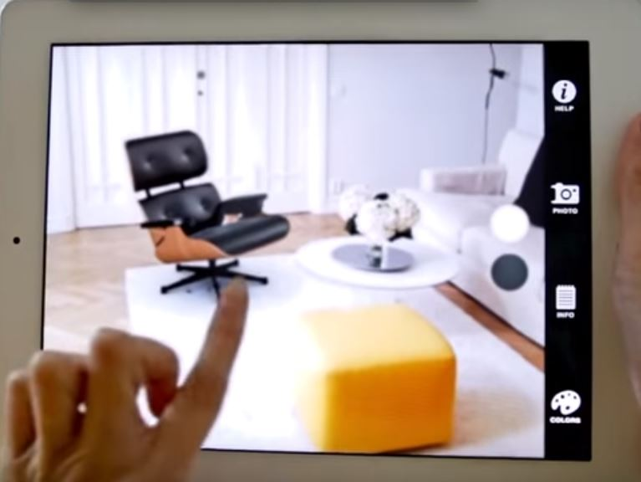
Existing Products
Sayduck
Using Vuforia, Sayduck developed a series of product visualization apps enabling consumers to see all kinds of products.
High-end furniture manufacturers and retailers immediately grasped the value of having such virtual showroom apps.
Markless
Furniture

Slide 10
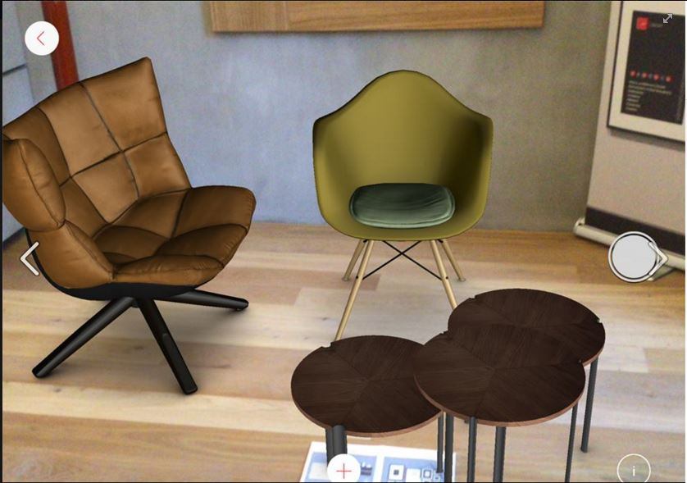
Existing Products
Augmented furniture
Visualize your selection of objects inside your own room and to make a better evaluation of how it will fit in your own living room.
Can configure furniture color, material or texture or you can combine it with other objects
Markless
Furniture

Slide 11











Comparison of Existing Products
Features
Augment
VIUTEKuDecoreEK
Sayduck
Augmented Furniture
Our Solution
Medium
Marker-less AR
Support multiple objects
Support customization In app user feedback
Suggestion feature
Voice recognition
In app purchasing
Marker-less AR
Support multiple objects
Support customization In app user feedback
Augmented object details
Support android
Scale detection

Slide 12




Main Objectives
Features provided by the proposed system
AR furniture placement
3D models of furniture which can be placed in their home to identify where it suit them before purchasing actual product.
Customize furniture
Customize furniture as customer requires.
Voice recognition
Allow customer the ease of customizing.
Furniture Suggestions
Allow customer the ease of customizing.
Markless
Furniture

Slide 13










Specific Objectives
Specific objectives achievable by proposed system
Scan real world
Scan the real world environment and provide data necessary for marker-less AR.
Identify scale
Identification of position and scale of object with respect to the surrounding.
Multiple objects
Provide means to add multiple object onto the environment.
Color histogram
Identify and record color histogram to be used in suggestion for furniture.
Suggestions
identify prominent colours and recommend most suitable furniture for the environment.
.
Voice commands Track the object and apply the voice commands for tracked object by identifying customer’s voice.
Voice customize
Provide customizing options via Voice command system.
Text to Voice
Provide details in augmented voice format.
Filtered Search
Provide services that allow filter furniture search based on budget and other space specifications.
Web portal
Provide a web portal for dealer to upload the furniture and their respective customization features.

Slide 14
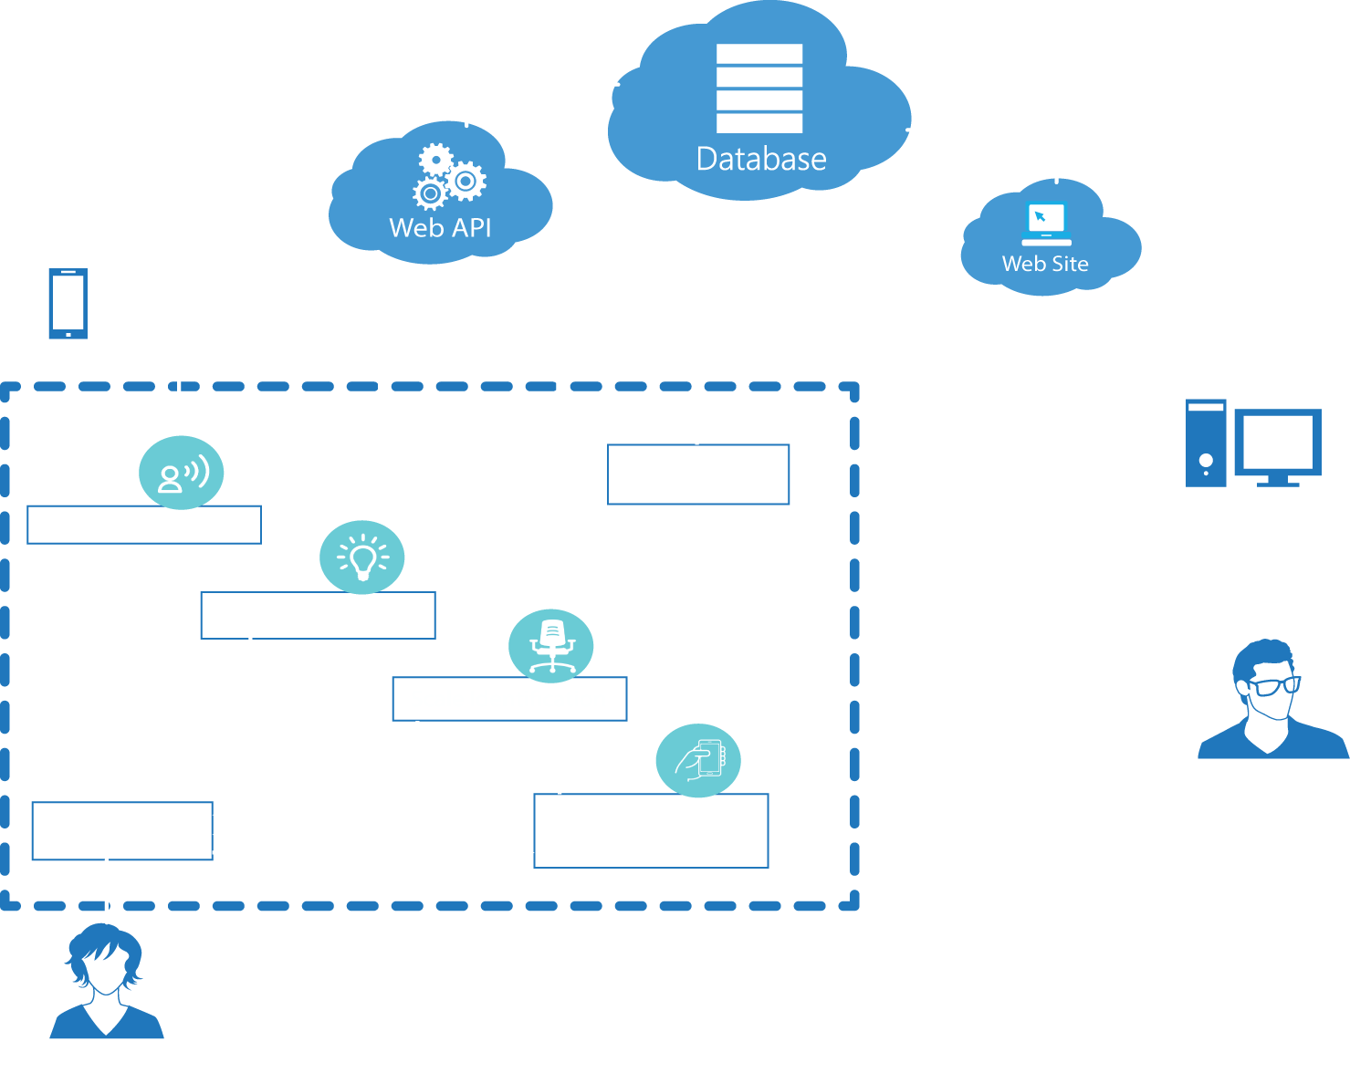
System Diagram
Markless
Furniture

Slide 15
Methodology
Markless
Furniture

Slide 16
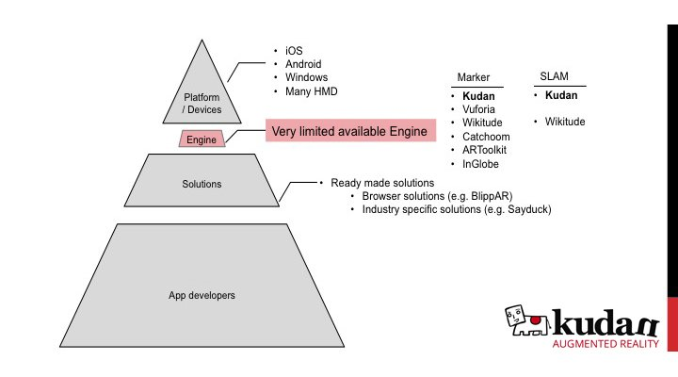
Existing Technologies for Augmented Reality

Slide 17
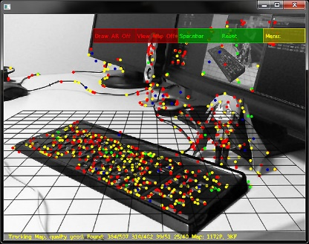
Research done on SLAM
M. Montemerlo, S. Thrun, D. Koller and B. Wegbreit, "FastSLAM: a factored solution to the simultaneous localization and mapping problem“ (2002 introduced for Robotics) ^{[1]}
G. Klein and D. Murray, "Parallel Tracking and Mapping on a camera phone” (2009) ^{[2]}
P. Martin, E. Marchand, P. Houlier and I. Marchal, "Mapping and re-localization for mobile augmented reality“ (2014) ^{[3]}
[1]A. Comport, E. Marchand, M. Pressigout and F. Chaumette, "Real-time markerless tracking for augmented reality: the virtual visual servoing framework", IEEE Trans. Visual. Comput. Graphics, vol. 12, no. 4, pp. 615-628, 2006.
[2]G. Klein and D. Murray, "Parallel Tracking and Mapping on a camera phone", 2009 8th IEEE International Symposium on Mixed and Augmented Reality, 2009.
[3]P. Martin, E. Marchand, P. Houlier and I. Marchal, "Mapping and re-localization for mobile augmented reality", 2014 IEEE International Conference on Image Processing (ICIP), 2014.
Markless
Furniture
SLAM : Simultaneous Localization and mapping

Slide 18

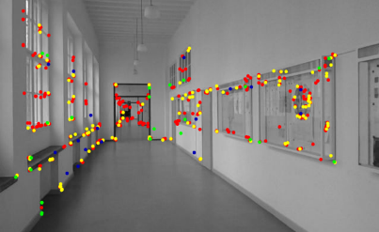
SLAM based mapping of room
Mapping and 3D object placement component Flow
Extract furniture models
Select 3D object
Scale identification component
Initiate Scanning &
obtaining tracking features
Identify direction &
number of
visible tracking features
Placement/relocation of objects
into the environment
Markless
Furniture

Slide 19
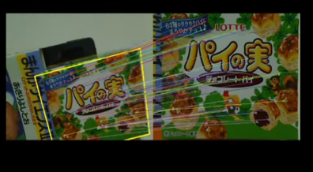
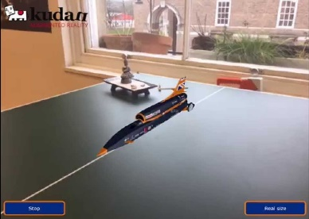
SLAM based mapping of room
Arbitrary tracking
Iterative mapping
Object placement
Arbitrary tracking to track current features in the real world.
Detection of point when tracking in lost and initializing arbitrary tracking again
Multiple object placement and identify the directions of viewing the objects
SLAM : Simultaneous Localization and mapping
Markless
Furniture

Slide 20
Research done on Scale Identification
[1] Sisi Zlatanovaa, George Sitholeb, Masafumi Nakagawac, Qing Zhud,” PROBLEMS IN INDOOR MAPPING AND MODELLING”, The International Archives of the Photogrammetry, Remote Sensing and Spatial Information Sciences, Volume XL-4/W4, 2013 ISPRS Acquisition and Modelling of Indoor and Enclosed Environments 2013, 11 – 13 December 2013, Cape Town, South Africa
[2]C. Holzmann and M. Hochgatterer, "Measuring Distance with Mobile Phones Using Single-Camera Stereo Vision", 2012 32nd International Conference on Distributed Computing Systems Workshops, 2012.
[3] Mahdi Momeni-K., Sotirios Ch. Diamantas, Fabio Ruggiero and Bruno Siciliano,” HEIGHT ESTIMATION FROM A SINGLE CAMERA VIEW”
Markless
Furniture

Slide 21
Scale identification of Real-world objects
Mapping and 3D object placement component Flow
Isolate Objects
Get accelerometer readings, and Camera Focal Length
Camera feed
Derive Pitch angle, Height of the camera(respect to ground)
Display relevant furniture details
Calculate Other Dimensions
Estimate Height of the object
Markless
Furniture

Slide 22
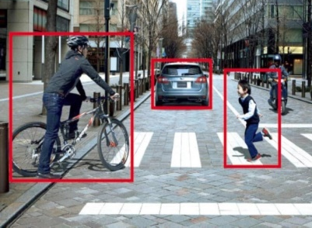
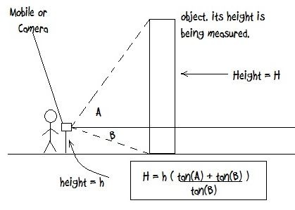
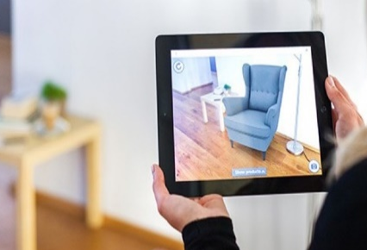
Scale Identification of real-world objects
Iterative mapping
Isolate Objects
Scale Algorithm
Object placement
Identify and isolate distinct object in the environment
Calculate Dimensions through inputs from accelerometer , focal length of camera.
Give inputs to scale the 3D object to be more realistic.
Markless
Furniture

Slide 23




Research done on Voice Recognition
Just Speak in Android ^{[1]}
  Implemented methodology of speak recognition is transcribe the spoken speech in to text format by google researchers
LookTel Application ^{[2]}
  Application of electronic assistant for visually impaired and blind.
Augmented Audio ^{[3]}
  For match the audio according to the environment (Engineering Society Journal)
Bundles adjustment technique^{[4]}
  For lock the camera pointed object (IEEE Transactions on Visualization and Computer Graphics)
[1] “ JustSpeak: Enabling Universal Voice Control on Android” by Yu Zhong, T.V. Raman, Casey Burkhardt, Fadi Biadsy and Jeffrey P. Bigham; Google research publication 2004
[2] LookTel: electronic assistant for visually impaired and blind. http://www.looktel.com [27 April 2012].
[3] “Augmented Reality Audio for Mobile and Wearable Appliances” , Engineering Society Journal , Audio Engineering Society, Vol. 52, No. 6, 2004 June
[4] “IEEE Transactions on Visualization and Computer Graphics”, Vol. 12, No. 4, 2006 July/August
Markless
Furniture

Slide 24

Voice Recognition
Voice Recognition and customizing flow
Voice recognition algorithm
Acquire Image
And
Voice
Convert voice to Text
Extract furniture
detail
Apply Voice commands
Send output to mobile application
Display updated furniture
Text to voice convert algorithm
Voice description
Convert Text to Voice
Markless
Furniture
Notes:
Algorithms
voice to text: just speak in android
text to voice: TTS speech synthesis

Slide 25

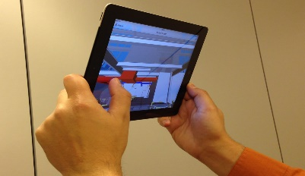
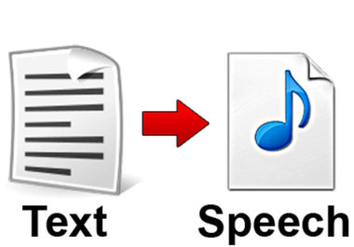
Voice Recognition
Provide voice customization options for furniture
identifying user’s voice
Identify the object
Narration of details
Identifying users voice and translate it into text format to be compared with command.
identify closest 3D object in the view of the camera.
Converting the text description to speech and give it in augmented audio .
Markless
Furniture
Notes:
Algorithms
voice to text: just speak in android
text to voice: TTS speech synthesis by google (augmented audio)

Slide 26
Research related to Image Processing
Chhaya S.V., Khera S., Kumar P., "BASIC GEOMETRIC SHAPE AND PRIMARY COLOUR DETECTION USING IMAGE PROCESSING ON MATLAB", International Journal of Research in Engineering and Technology, vol. 04, no. 05, pp. 505-509, 2015.
B. Kaur and S. Jindal, "Content based Image Retrieval with Graphical Processing Unit", 2016, Telecommunication and Computing, ITC.
Markless
Furniture

Slide 27

Real-time suggestions
Suggestions component Flow
Acquire Image
Upload to cloud server
Preprocess image
(Histogram processing)
Extract color information
Feed input to suggestion algorithm
Display relevant furniture details
Send output to mobile application
Markless
Furniture

Slide 28
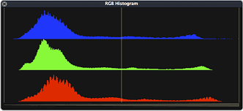


Real-time Suggestions
Provide real-time suggestions for furniture
Histogram Processing
Analyze the colors
Suggestions as output
Identify the prominent colors present when scanning the environment.
Upload the colors onto a web-service and analyze the colors against the furniture
Provide recommendation of furniture with respect to the analysis done
Markless
Furniture

Slide 29
Web Portal methodology
Web Portal
Provide location for registering dealer’s company
Provide location for uploading 3D model of furniture
Provide location to insert details with respect to customization of furniture
Identify and Handle each furniture and their respective customizations
Markless
Furniture

Slide 30

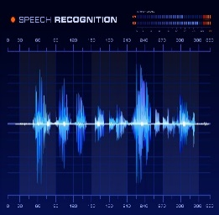
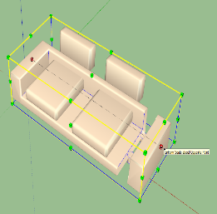


Work Breakdown
Team members and their respective work
SLAM based mapping
Voice Recognition
Scale identification
Furniture Suggestions
N. J. Silva
Team Leader
A. K. S. Y. Alawatta
R. K. A. D. C. Ranaweera
D. G. T. K. Jayathilaka
3D tracking and mapping of Environment
Assigning and display of furniture and details
Furniture Customization
Voice recognition
Identification of focused objects
Narration of furniture details
Identification of real scale
Matching scale of 3D object to real world
In-app purchasing
Obtaining Prominent Colours
Furniture suggestion algorithm
User Feedback
Web application
Markless
Furniture

Slide 31
Gantt Chart
Markless
Furniture

Slide 32







Technology
Technology to be used for development
Kudan AR
Unity 3D
Android device
Azure cloud service
Android SDK
Open CV
Microsoft SQL server
Microsoft Visual Studio 2015
Markless
Furniture

Slide 33
Users
Furniture dealers
Furniture architects
Customers
Markless
Furniture

Slide 34






Achievable User Benefits of the System
Increase of Profitability
Retain Customers and Improve customer service
Markless
Increase of customer satisfaction
Furniture
Less burden on furniture transporter
Motivation and improve of customer feedbacks
Improvement to quality of products
Markless
Furniture

Slide 35

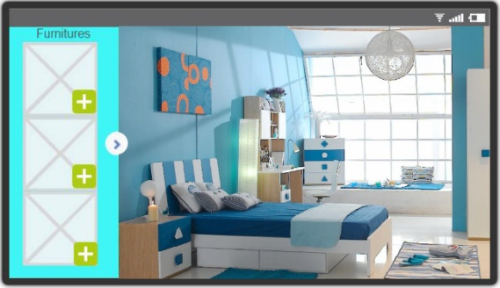




Final Product
produce a mobile system that can be used to augment 3D furniture at real scale onto real world without predefined markers and be able customize those said furniture through an augmented interface or voice commands with the options provided by the dealer. Main development areas and their sub sections are as follows.
Augmented Reality
Voice Recognition
Instant Suggestions
Markless
Furniture

Slide 36
Marketing Plan
WEB Portal
API
Social Media
Markless
Furniture

Slide 37
Thank You

