Slide 1
Markless
Furniture
Marker-less AR furniture Interactive Layouting

Slide 2
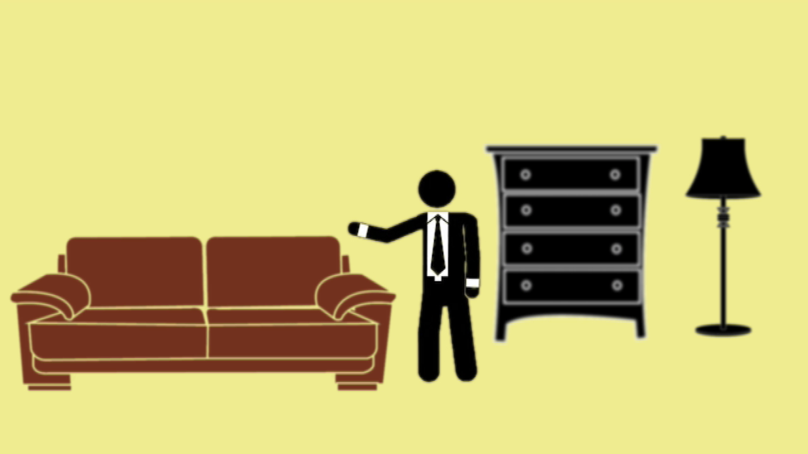
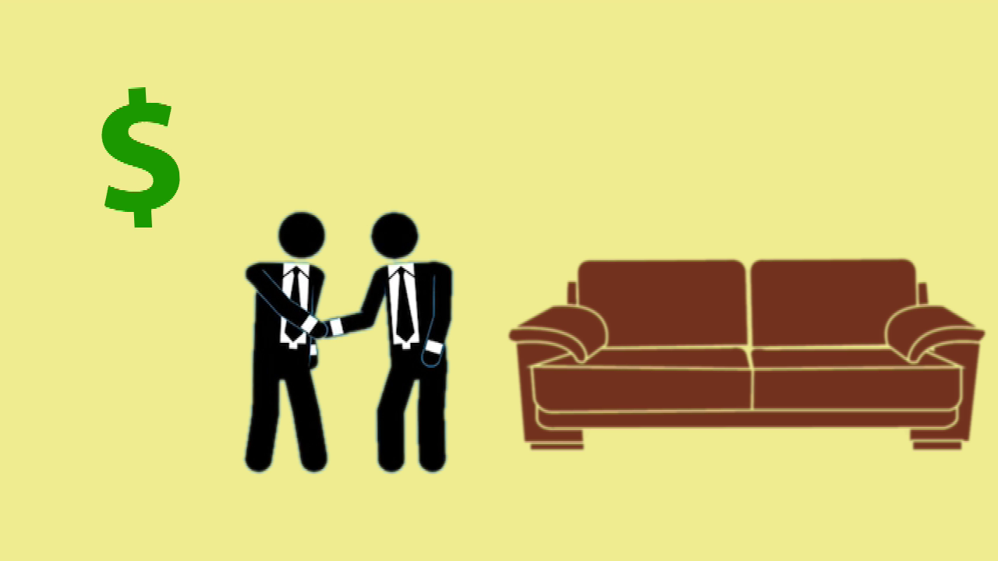

Real World Problem

Slide 3
Welcome to Markless Furniture
Marker-Less AR furniture interactive Layouting
Augmented Reality is an image processing technique which uses a mobile device’s camera to superimpose a computer-generated image or 3D model on to a user’s view of the real world
Markless
Furniture

Slide 4
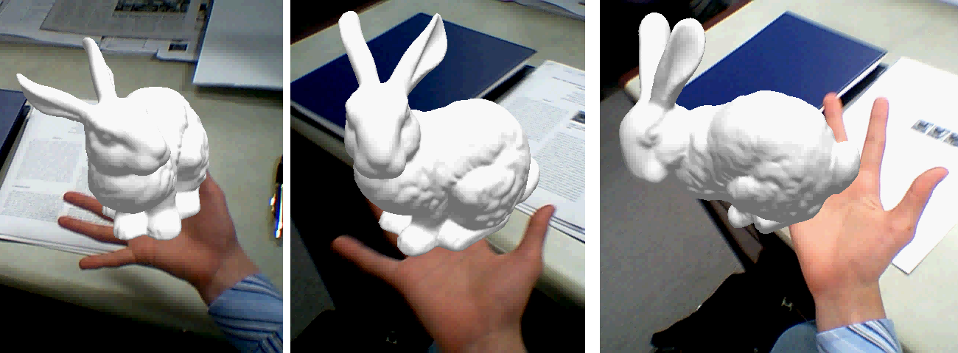
Marker-less AR
Image are not provided beforehand.
Recognition algorithm running in your AR application should identify patterns, colors.
Markless
Furniture

Slide 5




Main Objectives
Features provided by the proposed system
AR furniture placement
3D models of furniture which can be placed in their home to identify where it suit them before purchasing actual product.
Customize furniture
Customize furniture as customer requires.
Voice recognize
Allow customer the ease of customizing.
Furniture Suggestions
Allow customer the ease of customizing.
Markless
Furniture

Slide 6
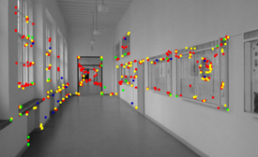
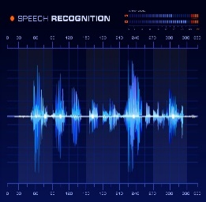
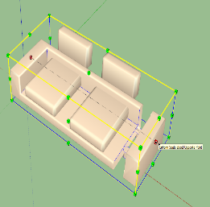
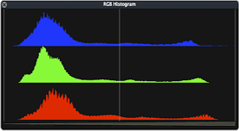

Demonstration Breakdown
Team members and their respective work
Furniture placement and customization
Voice Recognition
Scale identification
Furniture Suggestions
N. J. Silva
Team Leader
A. K. S. Y. Alawatta
R. K. A. D. C. Ranaweera
D. G. T. K. Jayathilaka
3D tracking and mapping of Environment
Assigning and display of furniture and details
Furniture Customization
Voice recognition
Identification of focused objects
Narration of furniture details
Identification of real scale
Matching scale of 3D object to real world
In-app purchasing
Obtaining Prominent Colours
Furniture suggestion algorithm
User Feedback
Web application
Markless
Furniture

Slide 7











Comparison of Existing Products
Features
Augment
VIUTEKuDecoreEK
Sayduck
Augmented Furniture
Our Solution
Medium
Marker-less AR
Support multiple objects
Support customization In app user feedback
Suggestion feature
Voice recognition
In app purchasing
Marker-less AR
Support multiple objects
Support customization In app user feedback
Augmented object details
Support android
Scale detection

Slide 8
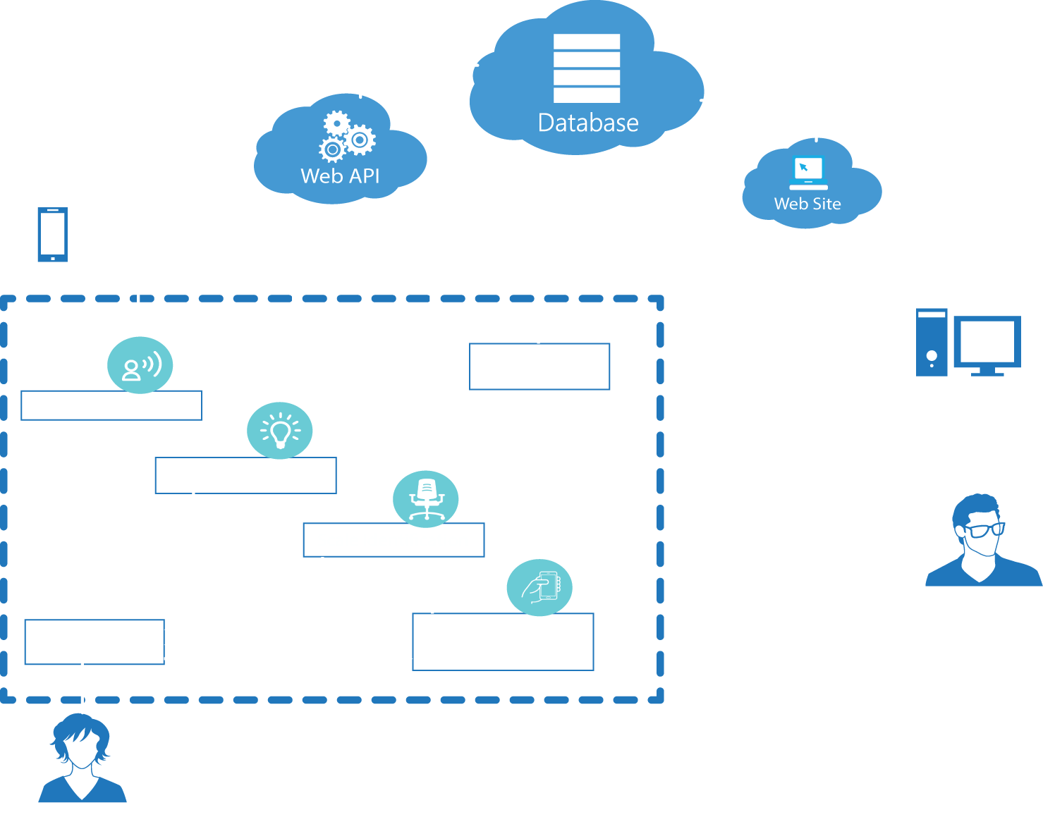
System Diagram
Markless
Furniture

Slide 9
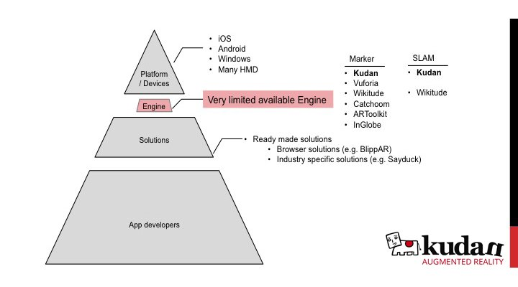
Existing Technologies for Augmented Reality

Slide 10








Technology
Technology to be used for development
Kudan AR
Unity 3D
Android device
Azure cloud service
Android SDK
Open CV
Microsoft SQL server
Microsoft Visual Studio 2015
Amazon Web Services S3
Markless
Furniture

Slide 11
Thank You

